Slide 1

Kholoud Khaled • Ereny Osama • Lamia Abdelhady • Kerolos El Mallakh | Supervised by Eng. Khlood Raga & Eng. Youssef Ayman | National Telecommunication Institute (NTI)

Slide 2

OVERVIEW
Agenda
💳
01
The Problem
🧭
02
Our Approach
Why credit risk matters
How we tackled it, step by step
📊
03
The Dataset
🧹
04
Exploration & Cleaning
What we worked with
Understanding & preparing the data
🤖
05
Modeling
✅
06
Results & Insights
Comparing & tuning models
Final performance & key drivers
🔍
07
Bonus Analysis
🚀
08
Conclusion
PCA & customer segmentation
Impact & what's next
02

Slide 3

THE CHALLENGE
The Problem
Every loan a bank approves carries a risk: the borrower may default. Manual assessment is slow, inconsistent, and hard to scale — machine learning can flag high-risk applicants automatically, before the loan is approved.
32,581
21.8%
📄
Loan Applications
Historical Default Rate
12
Applicant & Loan Features
🧮
Our Goal: Build a classifier that predicts whether a loan applicant will default, enabling faster, data-driven lending decisions.
Data-driven
risk scoring
03

Slide 4
BUSINESS PLANNING
Our Approach
From raw data to a deployable risk-scoring model — in six deliberate stages.
1
2
3
4
5
6
📥
🧹
⚙️
🤖
🎯
🚀
Data Collection
Cleaning & EDA
Preprocessing
Modeling
Tuning
Deploy-Ready
32,581 real loan records with 12 applicant & credit features
Fixed missing values, duplicates & outliers; explored key patterns
Encoding, scaling, stratified split — leakage-safe pipeline
3 algorithms trained & compared under identical conditions
GridSearchCV cross-validation to optimize for F1 / Recall
Final model + insights ready for real-world integration
Why this order matters: Each stage validates the one before it — clean data before modeling, tuned models before comparison — so the final choice is defensible, not accidental.
04

Slide 5
THE DATA
Dataset Overview
👤
💰
📋
Applicant Info
Loan Info
Credit History
Age, income, home ownership, employment length
Amount, intent, interest rate, credit grade (A–G)
Prior default on file, credit history length
TARGET DISTRIBUTION — loan_status
⚠️ Key Challenge
The dataset is imbalanced (~4:1). A naive model could reach 78% accuracy by predicting “no default” every time — so accuracy alone is misleading.
No Default — 78.2%
Default — 21.8%
05

Slide 6
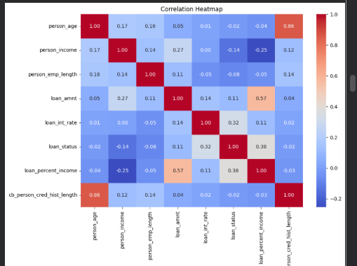
DATA EXPLORATION
Exploring the Data
Correlation Heatmap
✓
loan_percent_income (0.38) and loan_int_rate (0.32) are the strongest numeric predictors of default
✓
person_age and cb_person_cred_hist_length are highly correlated (0.86) — flagged as multicollinearity
✓
Tree-based models (Random Forest, XGBoost) are largely unaffected by this, so both features were kept
06

Slide 7
PREPARATION
Data Cleaning
❓
🗑️
⚠️
Missing Values
Duplicates
Invalid Outliers
895 + 3,116
165 rows
7 rows
employment length & interest rate — filled with median (robust to outliers)
fully duplicated records removed
impossible ages (>100) and employment length exceeding age, removed
32,581 → 32,409 rows: After removing duplicates and invalid records, the dataset shrank by just 0.5% — preserving nearly all of the original signal.
07

Slide 8
GETTING MODEL-READY
Preprocessing Pipeline
1
2
3
4
📉
🔢
✂️
📐
→
→
→
Log Transform
Encoding
Train / Test Split
Feature Scaling
Reduce skew in income
Label + One-Hot encoding
80 / 20, stratified
StandardScaler (fit on train only)
Encoding and scaling were fit only on the training set, then applied to the test set — avoiding data leakage.
08

Slide 9
A KEY DECISION
Handling Class Imbalance
With ~78% of applicants repaying and only ~22% defaulting, an untreated model naturally learns to favor the majority class. We corrected for this at the model level:
⚖️
class_weight='balanced'
⚖️
scale_pos_weight
Used in Random Forest to up-weight minority-class errors during training
XGBoost's equivalent — computed from the train-set class ratio (~3.6)
🎲
Stratified Split
🎯
F1-optimized Tuning
80/20 split preserved the 78/22 ratio in both train and test sets
GridSearchCV scored on F1, not accuracy — avoiding a majority-class bias
09

Slide 10
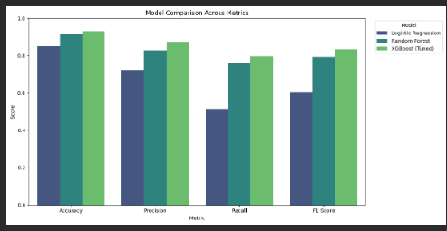
MODELING
Comparing Three Models
📐
Logistic Regression
Simple linear baseline
🌳
Random Forest
Ensemble of decision trees
⚡
XGBoost
XGBoost | Random Forest | Logistic Regression | Scale
91.8% | 91.3% | 85.1% | Accuracy
81.1% | 82.7% | 72.3% | Precision
81.7% | 76.0% | 51.6% | Recall
81.4% | 79.2% | 60.2% | F1 Score
Gradient-boosted trees — our final pick
10

Slide 11
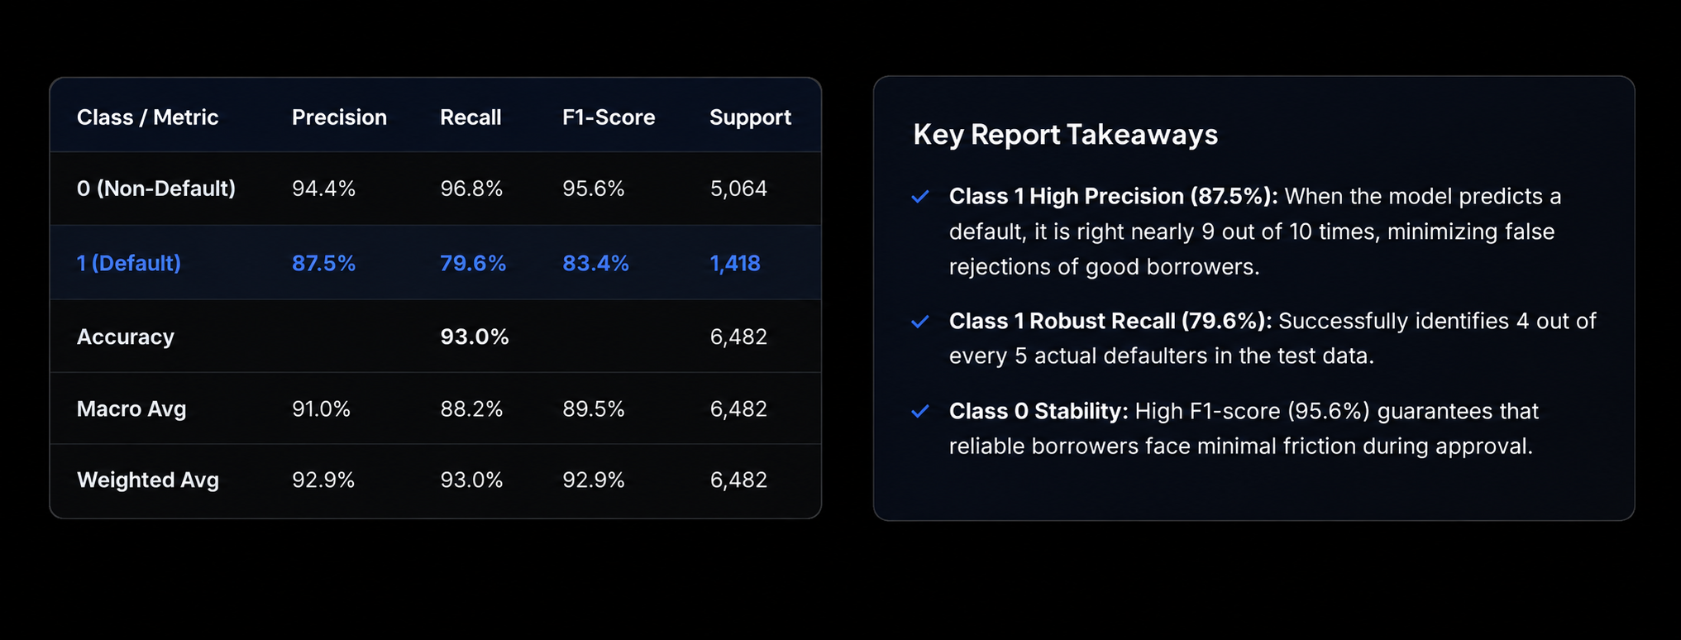
OPTIMIZATION
Classification Report Table
Detailed performance evaluation across classes (Non-Default vs. Default)
Model
Accuracy
Precision
Recall
F1 Score
XGBoost (chosen)
93.0%
87.5%
79.6%
83.4%
Random Forest
93.5%
96.2%
73.1%
83.0%
Why XGBoost: In credit risk, missing a defaulter (low recall) costs more than a false alarm. XGBoost delivers the highest Recall (79.6%) and the best overall F1-score among tuned models — catching more real defaulters while keeping precision strong.
11
11

Slide 12
OPTIMIZATION
Tuning & Final Choice
Random Forest and XGBoost were tuned with 3-fold cross-validated GridSearchCV, optimizing for F1-score.
Model
Accuracy
Precision
Recall
F1 Score
XGBoost (chosen)
93.0%
87.5%
79.6%
83.4%
Random Forest
93.5%
96.2%
73.1%
83.0%
Why XGBoost: In credit risk, missing a defaulter (low recall) costs more than a false alarm. XGBoost delivers the highest Recall (79.6%) and the best overall F1-score among tuned models — catching more real defaulters while keeping precision strong.
12

Slide 13
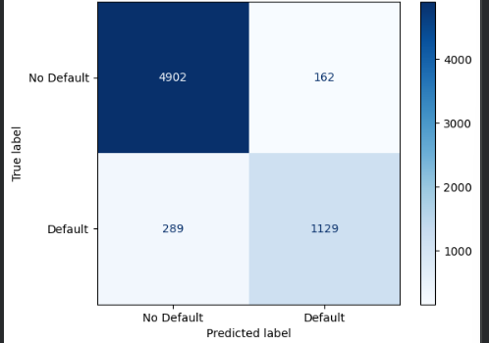
PERFORMANCE
Final Model Results
93.0%
87.5%
Accuracy
Precision
79.6%
83.4%
Recall
F1 Score
Bottom line: Correctly identified 1,129 of 1,418 real defaulters — catching 4 out of 5 high-risk applicants before the loan is approved.
XGBoost — Confusion Matrix
13

Slide 14
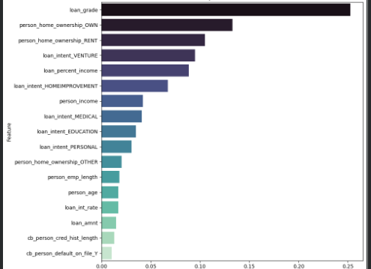
MODEL INSIGHTS
What Drives Default Risk?
25.3%
Loan Grade
The strongest predictor — the bank's own credit rating
13.3%
Home Ownership — Own
Owning a home is linked to lower default risk
10.5%
Home Ownership — Rent
Renting is linked to higher default risk
9.5%
Loan Intent (Venture)
Business/venture loans carry more risk
14

Slide 15
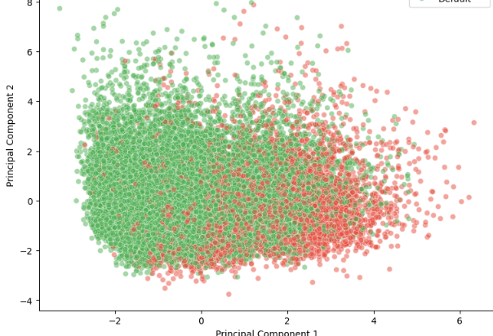
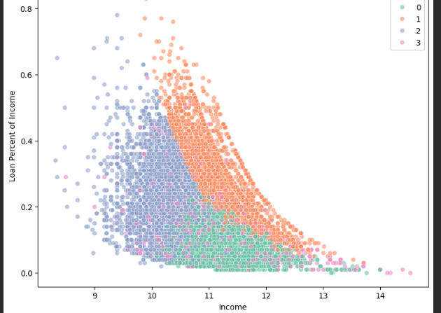
GOING FURTHER
Bonus Analysis
PCA — 2D Visualization
K-Means — Customer Segments
Independent confirmation: Unsupervised clustering, run without seeing loan_status, found the riskiest customer segment defaults over 5× more often than the safest — matching the supervised model's findings.
15

Slide 16
WRAPPING UP
Conclusion & Future Work
✅ Conclusion
🔮 Future Work
SafeLend uses a tuned XGBoost model to flag high-risk loan applicants with 93% accuracy and 79.6% recall — catching 4 out of 5 real defaulters, driven primarily by credit grade and home ownership status.
→
Deploy the model as a live API for real-time scoring
→
Test with SMOTE and larger, more diverse datasets
→
Add engineered features (e.g. debt-to-income ratios)
🚀 Impact
→
Build a monitoring dashboard for real-world drift
Faster, consistent, data-driven loan decisions — reducing manual review time while catching more high-risk applicants than a human-only process.
16

Slide 17
Thank You — Questions & Discussion | SafeLend: Predicting Loan Default with ML | NTI Graduation Project

